Slide 1

Rethinking Serverless With FLAME – Chris McCord
ElixirConf 2023
Roshan Poudel

Slide 2

Autoscaling
Client– Server Architecture -> Cloud Platforms like Heroku
Notes:
Talk about the client server architecture and how applications grew bigger and bigger with higher demand and traffic and consequently, workload.
Companies could no longer maintain in-house server as it would cost a lot to scale. Vertical scaling simply costed more and required replacing an entire server for a better one while horizontal scaling came with own integration and software challenges of its own. Plus, they required more space.
That’s when cloud providers became popular. Heroku, Google Cloud, Azure, AWS became popular.
They provided services for everything: storage, compute, private networks, and all.
Serverless – which is kind of a misleading word. There still is a server, just not in-house. You pay someone else to access their compute resources to run your applications and services.
So, Heroku said, you can autoscale your app. We will just stick your code and we will run em on a bunch of webservers.
But this has a serious problem

Slide 3
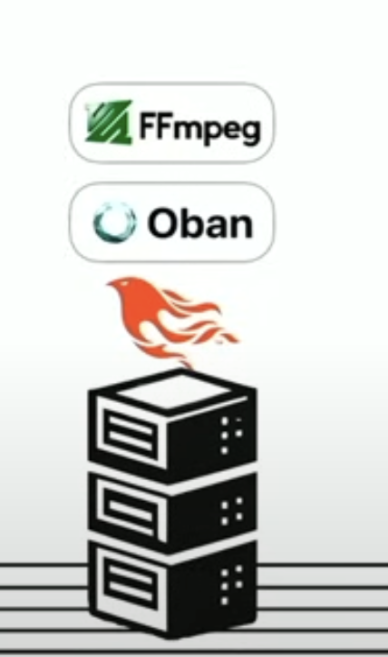
Notes:
Explain the image. (webserver, running phoenix, oban running background services, and anything else that the services doing eg. Video transcriptions.
Just a brief about Ffmpeg, it is the multimedia framework, able to decode, encode, transcode, mux, demux, stream, filter and play pretty much anything that humans and machines have created.
So Heroku says, awesome, you have to do a bunch of video transcriptions. And they say more web servers (change slide)

Slide 4
Notes:
Explain the image. (webserver, running phoenix, oban running background services, and anything else that the services doing eg. Video transcriptions.
So Heroku says, awesome, you have to do a bunch of video transcriptions. And they say more web servers (change slide)

Slide 5
Notes:
More servers. Yes, this essentially is a load balancer to split requests.
Yes, this gives us more capacity because those ffmpeg jobs are really expensive and we are using load balancers to distribute the workload to different webservers.
Yes, this works! But what we are doing is we are putting our web requests, api, liveviews, and html pages through the path of these ffmpeg jobs.
So, what do we do?

Slide 6
Autoscale Elastic scale
Notes:
So, instead of autoscale, something like elastic scale that can grow and shrink back down as needed.

Slide 7
Granular Elastic scale
Notes:
So, when we say scaling, we are not simply refering to the surface level scaling like adding more web servers.
We have all these components in this app and if we have 1000 users on 1 server and you have 10 servers, you say oh! I can run 10000 users. Not really! The thing we are trying to scale here is not just web traffic. Sure, it works if you are trying to accommodate for 10000 more connections, then sure, starting all 10 more server works, but usually the things we try to scale are these individual granular pieces.
And that’s how you think about autoscale is finding the things in our app that are expensive and scale those.
<change slide>

Slide 8
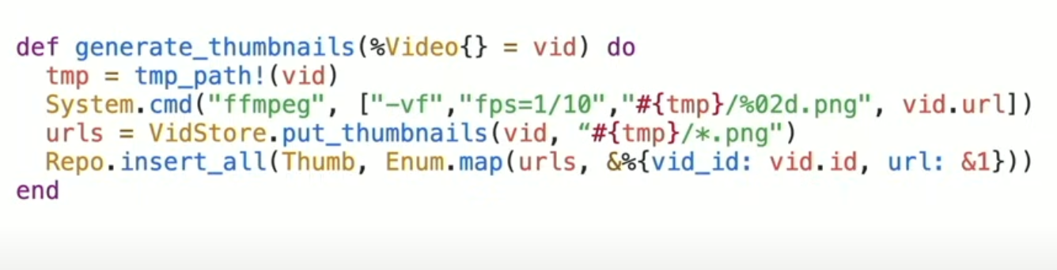
Notes:
But this one is a hard problem because what we are trying to do is say, write this naïve code in elixir and say here’s something that shells out to ffmeg to generate thumbnails.
Something which is very heavy CPU bound, IO bound.
Sure, I can write it in a few lines of code in my laptop and it works fine but wouldn’t it be nice, if I had to do something like this and not have to think about elastic scale or manage those servers, learn about Kubernetes, split into microservices. There’s a name for that, what would be the nice thing to call them?
<change slide>

Slide 9

serverless
Notes:
Serverless!!! Bad name. <change slide>

Slide 10
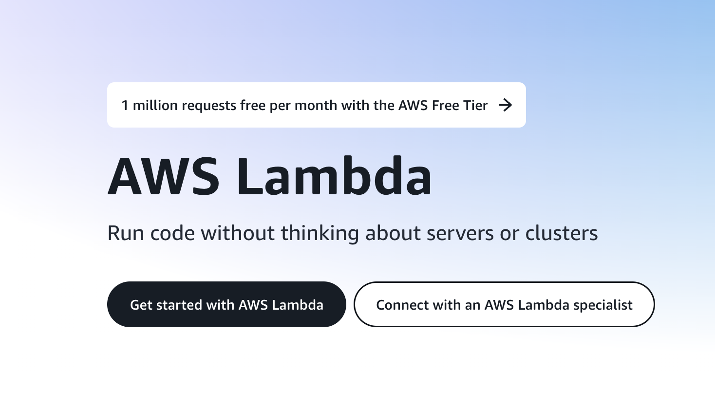
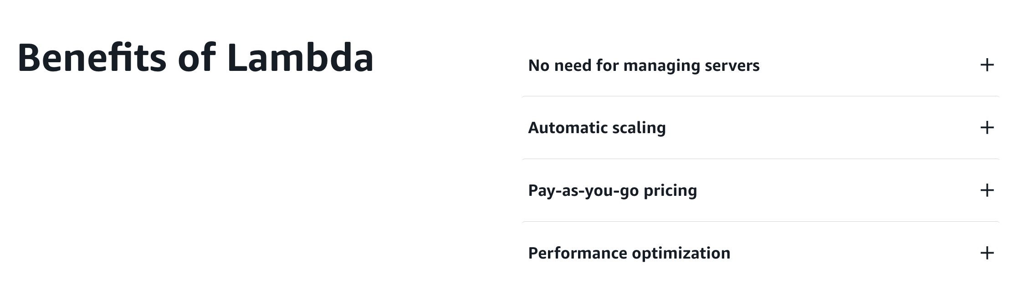
Notes:
And here’s things like AWS Lambda comes. To solve problems of granular elastic scale.
This tagline of not thinking about servers or clusters is silly but the problem it solves like you pay for what you use and it runs this granular piece of your code.
Issue about lambda is that it has an outrageous complexity.
<change slide>

Slide 11
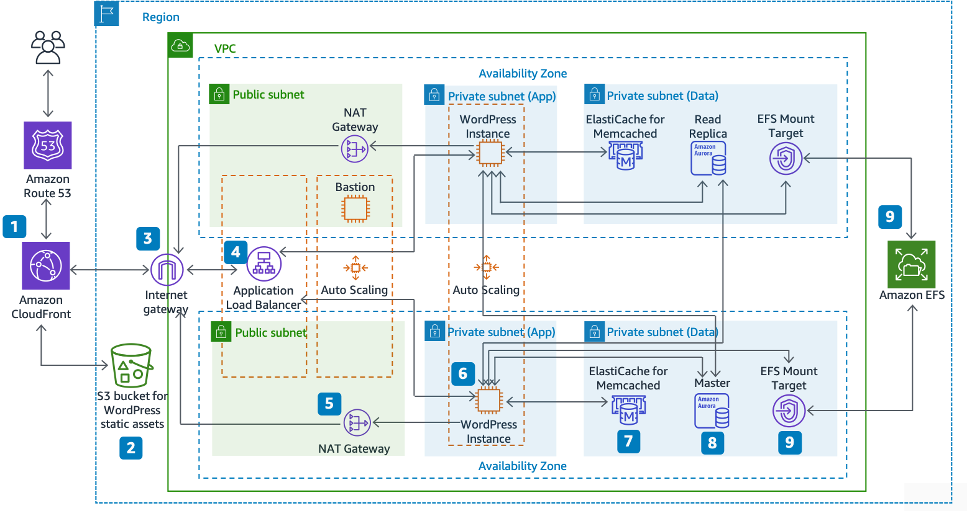
Reference architecture for hosting wordpress on aws
Notes:
You can literally still find this image on https://docs.aws.amazon.com/whitepapers/latest/best-practices-wordpress/reference-architecture.html
So, its just that lambda gives you this simple way to deploy code and run it, but you buy 8 of these other services on this ecosystem and it becomes this ton of nonsense
Something like this for hosting a wordpress site is ridiculous
<change slide>

Slide 12
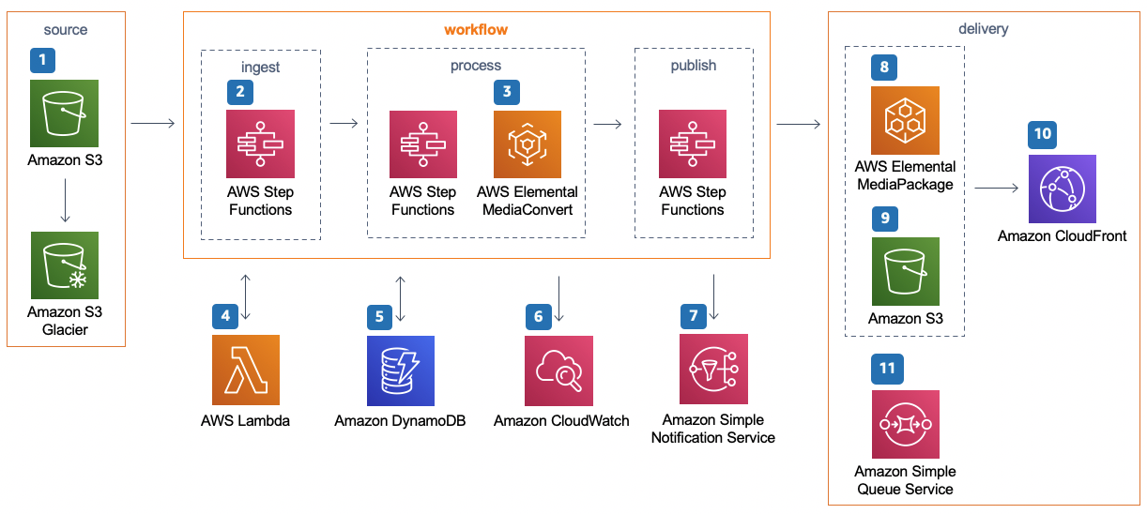
Aws reference architecture for video encoding
Notes:
Something more applicable is this one for video encoding.
This is how AWS recommends it, you do not have to worry about those pesky servers or clusters right??
Yaaaa, just put the video on S3 object storage bucket. That thing is gonna spin up lambda by calling a step function and lambda calls another function and lambda has 15 minute of execution time and you cannot encode videos there if they run for more than 15 minutes of encoding.
So you have to call another proprietary service like the elemental media convert. You pay for that.
That does something with cloudwatch it goes into another step function and triggers another amazon service for eg broadcast, which you again pay for
It goes into another elemental media package, the speaker said he does not know what that does, neither do I.
Now it puts the result in S3 and surprise! You cannot get the result of this thing in your app and so you put it in amazon Simple queue service which you also pay for
Then you go back to your app and you write simple queue SQ as consumer and that way you say okay this video has thumbnails for me now
Then cloudfront is in there for probably a content delivery network.
So, this is awesome, I am not thinking about servers at all right!!

Slide 13

Notes:
I am just thinking about all these 10 AWS services that call other AWS services. And I pay for them all.
Well, it solves the problem but you are paying for every step of this service.
Well Lambda because you only pay for what you use and lambda runs all your applications and instead of managing servers you are just managing these 10 other services.
Again, other unicorns like Datadog comes for your rescue, providing cloud monitoring services which you again pay for. Welp!

Slide 14
How can we make this better?
Notes:
<change slide>

Slide 15
How can we make this better?
USE FLAME
Notes:
<change slide>

Slide 16


Slide 17
FLAME: FLEETING LAMBDA APPLICATION FOR MODULAR EXECUTION
THE IDEA OF FLAME IS
“WE CAN RUN YOUR APP ON AN EPHEMERAL SERVER, SHORT LIVED AND ITS YOUR WHOLE APPLICATION CALLED MODULARLY IN SLICES AT ANY TIME”
Wouldn’t it be nice if we can just wrap our elixir code around flame and it would just scale it elastically ?

Slide 18
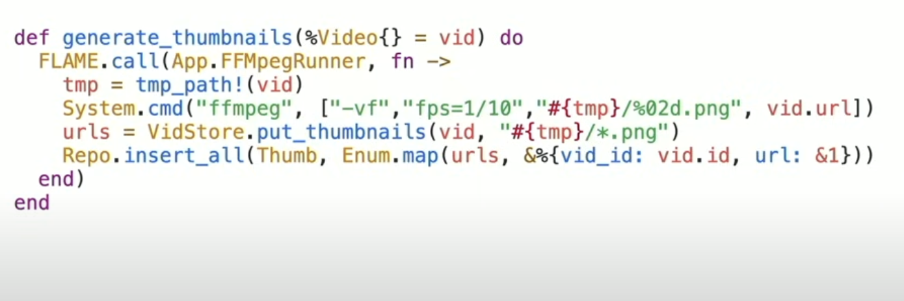
Notes:
We could wrap it in the flame call and that block of code now runs on a short-lived server running our whole application. Got elastic scale for us.
This is what flame does.
It allows you to wrap any code in your current app and that code will do what it need to do like shelling out Fffmpeg.
Notice that there is a repo insert all that inserts all thumbnails into the database.
You can start the supervision tree as normal, probably run a small database pool, call the repo, and and still do pops up broadcast.
You can use all the primitives of the language like the whole app with the beam.
This 3 lines of naïve code takes a video url. Ffmpeg will accept a URL and download a file and transcode it
But you have to make the video url public somewhere and you could say that is cheating because AWS had to put the file on S3
So, I am skipping the fact that AWS has to move the file close to lambda to pull it off and process it.
And we are overlooking that fact here. But not problem. We have BEAM.

Slide 19
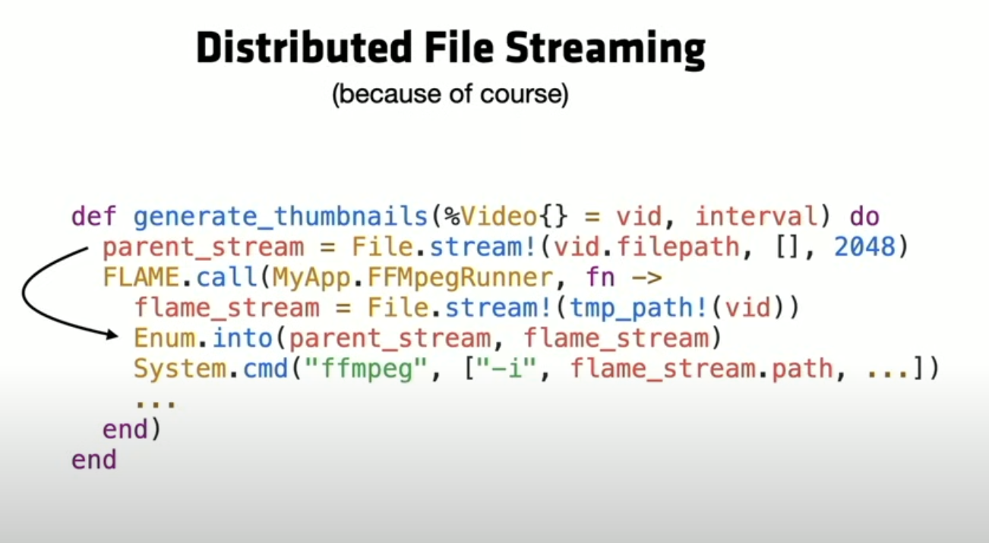
Notes:
We can just send the file over distributed erlang because thats how file IO works right every thing is a process
If I need to get that file onto the server instead of having the FFMpeg downloaded, I can just download two lines of code, call file stream on the parent
That is going to open a file which is another process. Say you want to stream that file in 2 thousand chunks and you could Enum them into the flame call and that will give you another node
And you could stream that file over. That’s just 2 line of code.
Now I have the file on the node that needs to process.
I did not have to put it on S3 and wait for that just to read it off and then delete it later. It’s like 2 lines of code and I am ready to go
Notice that we are just closing over state here. There’s a video struct in this interval and that just gets closed over in the closure and run on the other node and you did not have to think about that since beam already gives that. So, we did not have to rewrite the code in any way. You are just writing the flame call and you may have to write another two lines to move the file around.
Since everything in elixir is process based, so even if you have processes, liveviews, genservers that we are doing some code talking to the system and now you need to run this somewhere else, but how do I get the results back. Well, turns out you just run it somewhere else and since processes are location transparent, you almost never have to change code, it just sends messages back and forth.

Slide 20
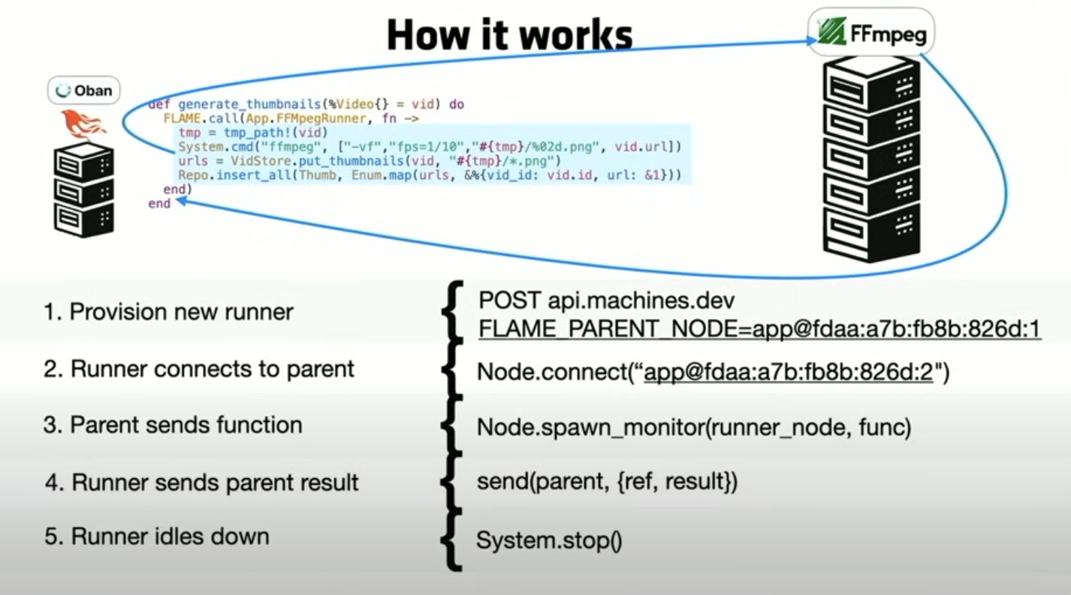
Notes:
There is flame Kubernetes in the backend so flame can run on any infrastructure that has a programmable API that takes server and run that code on it.
Kubernetes is an open-source platform for automating the deployment, scaling, and management of containerized applications.

Slide 21
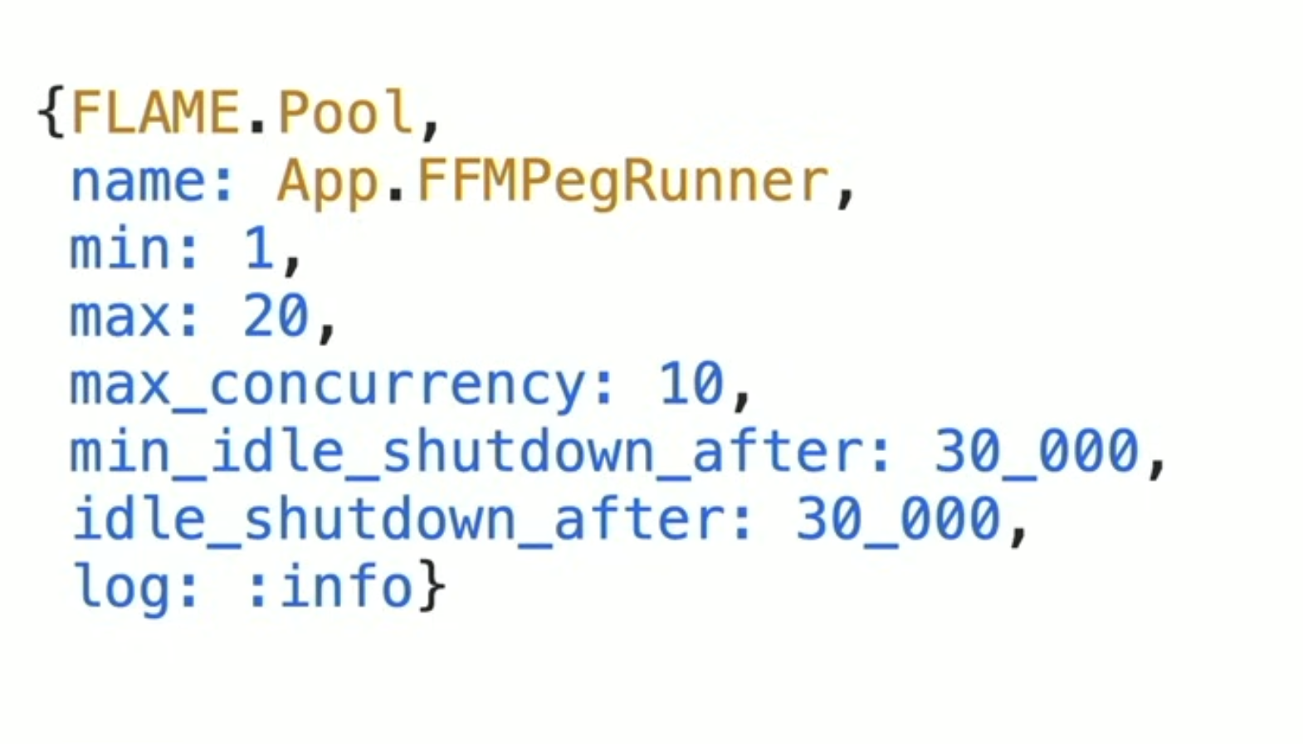
Notes:
Shutdown: Hangout for 30 s and then if there is no job left then shutdown the servers
Min 1 server running always because you do not want to have a cold start always. Kinda pay perpetually for that one live server

Slide 22
SOLVING vs removing the problem
THANK YOU!

Slide 23
Elixirconf 2023 - Chris McCord
https://www.youtube.com/watch?v=GICJ42OyBGg

